Slide 1

Estimation of DC motor load
Team: Alessia De Matteis, Andrea Guidi, Manuel Donsante
Course: Digital Control Systems
Academic Year: 2017/2018

Slide 2
Objectives
Estimation of DC motor parameters
Estimation of DC motor load
Design of a PI speed regulator
Estimation of DC motor load
2/27/18
Page 2

Slide 3
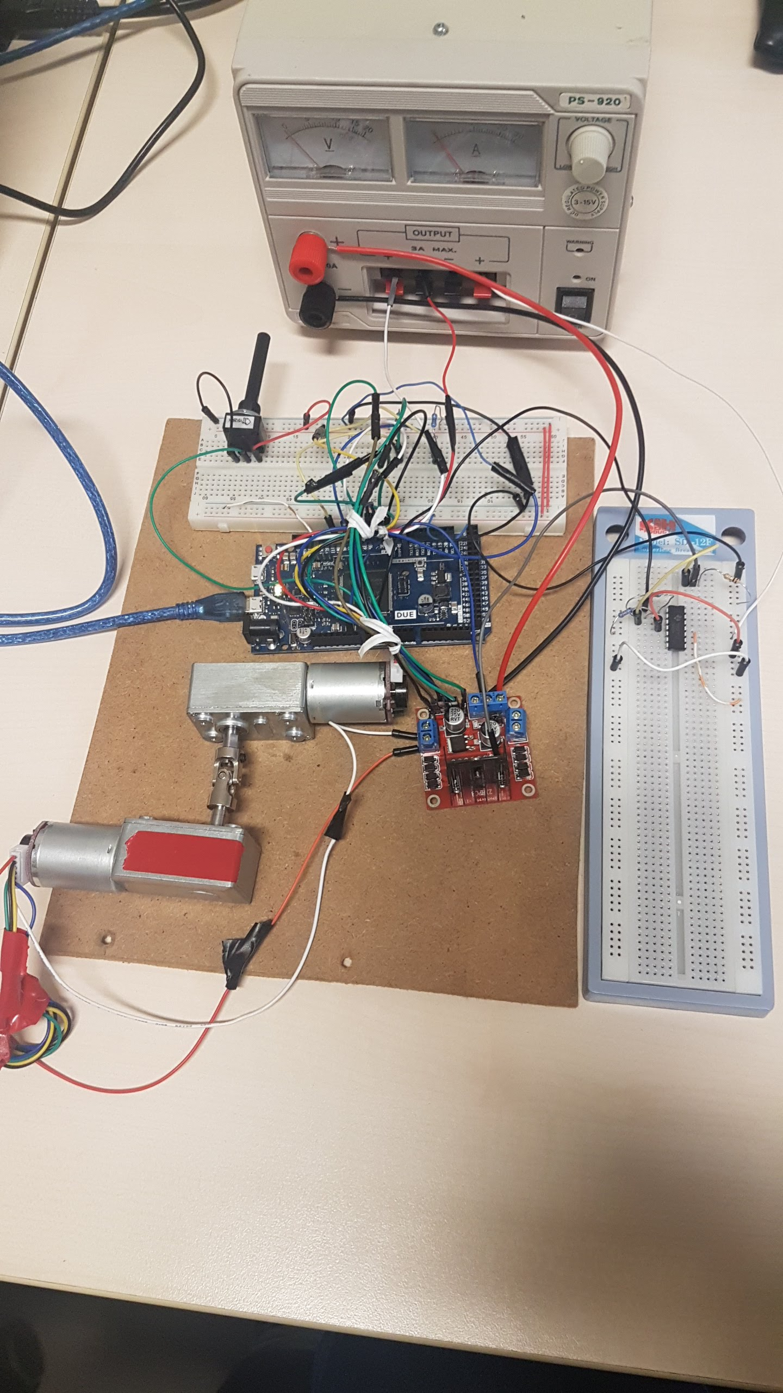
Estimation of DC motor load
2/27/18
Page 3

Slide 4
Hardware and software
Arduino Due (ARM Cortex-M3 CPU)
2x 12V DC Motor
Hall Effect Encoder
H-bridge: L298-N
Operational Amplifier: LM324N
1KΩ Potentiometer
Resistors: 2x 12KΩ, 2x 33KΩ, 1x 1Ω
12 V Power Supply – 20 A max
MATLAB 2017b
MATLAB Arduino support package
Fritzing
Estimation of DC motor load
2/27/18
Page 4

Slide 5
Hardware: Arduino Due
The Arduino Due is a microcontroller board based on the
Atmel SAM3X8E ARM Cortex-M3CPU.
It has 54 digital input/output pins (of which 12 can be used as PWM outputs) and 12 analog inputs.
Used to drive the motor by the H-bridge, to read the voltage from the potentiometer and to read the digital signal from the encoder.
Estimation of DC motor load
2/27/18
Page 5

Slide 6
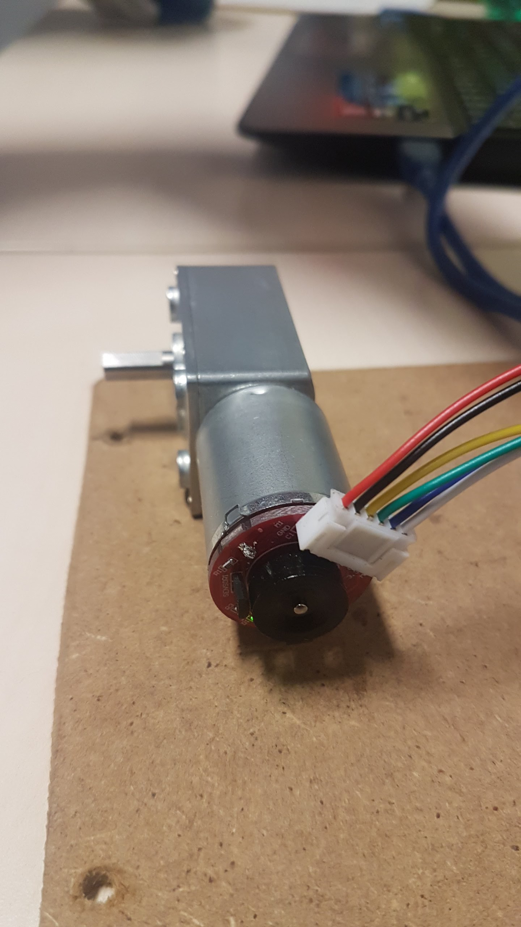
Hardware: DC Motors + Encoders
Operating voltage: 6V to 18V
Rated voltage: 12V
Reduction ratio: 40:1
No-load current: 40 mA
No-load speed: 150 RPM
Rated torque: 1.5 kg cm
Maximum torque: 6.4 kg cm
Stop current: 1.3 A
Hall Incremental Encoder
Encoder resolution: 440 CPR
Weight: 150 g
Red: Motor power +
Black: Encoder GND
Green: Encoder Phase A
Yellow: Encoder Phase B
Blue: Encoder power supply 5V
White: Motor power -
Estimation of DC motor load
2/27/18
Page 6

Slide 7
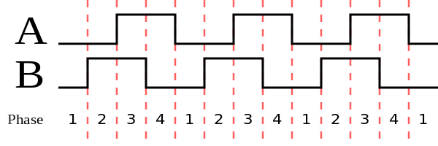
Incremental Encoders
Incremental encoders can measure relative displacements starting from an arbitrary position.
They use two digital outputs, A and B phases, set in quadrature.
B phase is commonly used for detecting sense of rotation.
MCUs generally use software interrupts for phase detection and counters to measure increments in position.
Estimation of DC motor load
2/27/18
Page 7

Slide 8
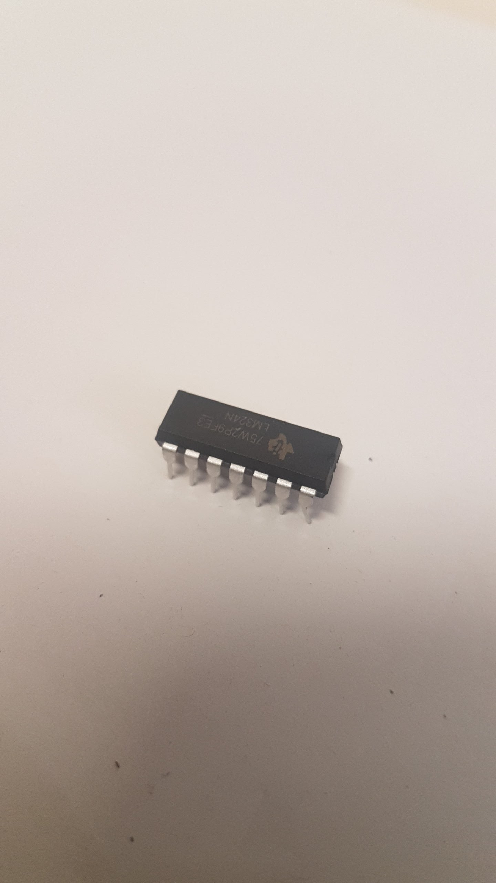
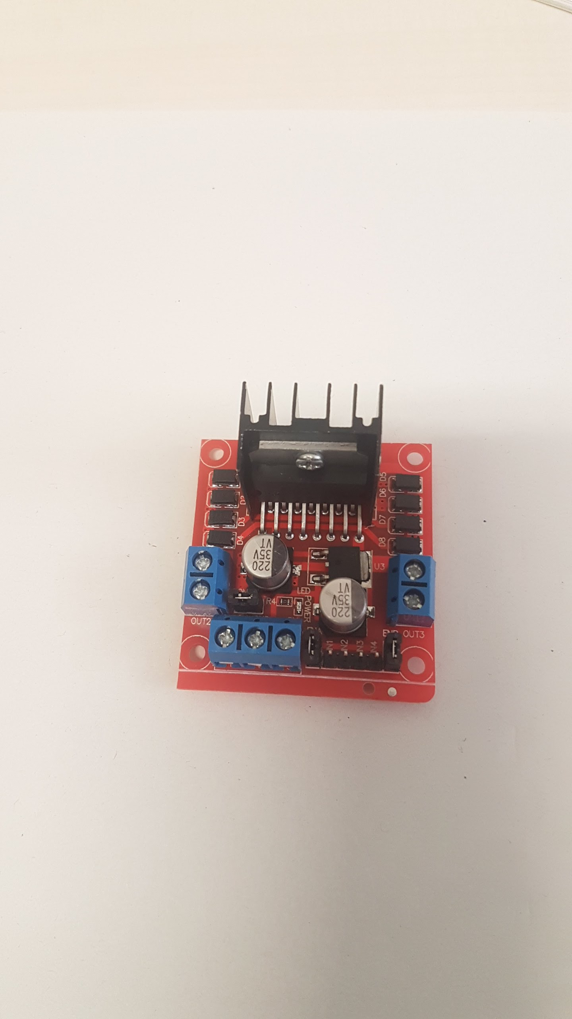
Hardware: L298-N and LM324N
The L298-N
Is a dual full-bridge driver capable of driving inductive loads such as motors
Can supply up to 2A per motor.
Has logic pins to allow to enable or disable motors (or speed regulation with PWM)
A pin for the connection of an external sensing resistor is available; (for this purpose,
a 1Ω resistor was connected to this pin)
The LM324N
Is a quad operational amplifier used for example as a DC gain block (as in our case).
Can operate from a single supply over a wide range of voltages.
It was used to amplify the voltage signal from the current sensing resistor on L298-N.
Estimation of DC motor load
2/27/18
Page 8

Slide 9
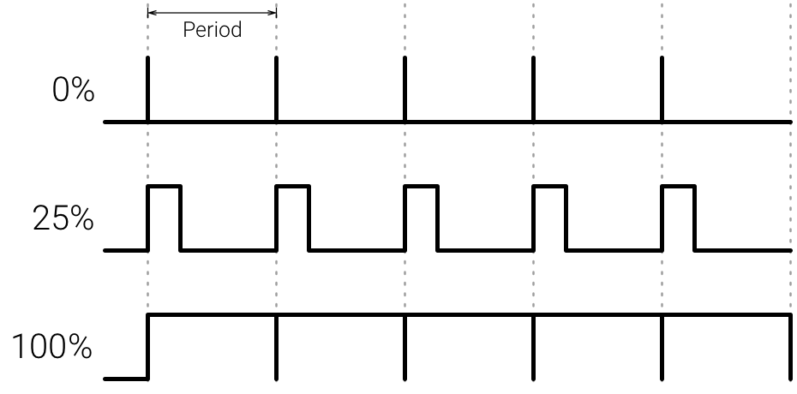
PWM (Pulse Width Modulation)
Pulse Width Modulation (PWM) is a technique of modulation of a digital signal.
It is based on generating a square wave with fixed frequency but variable duty cycle d.
It can be used to drive power systems without affecting performances (such as DC motors).
Duty cycle:
Estimation of DC motor load
Page 9

Slide 10
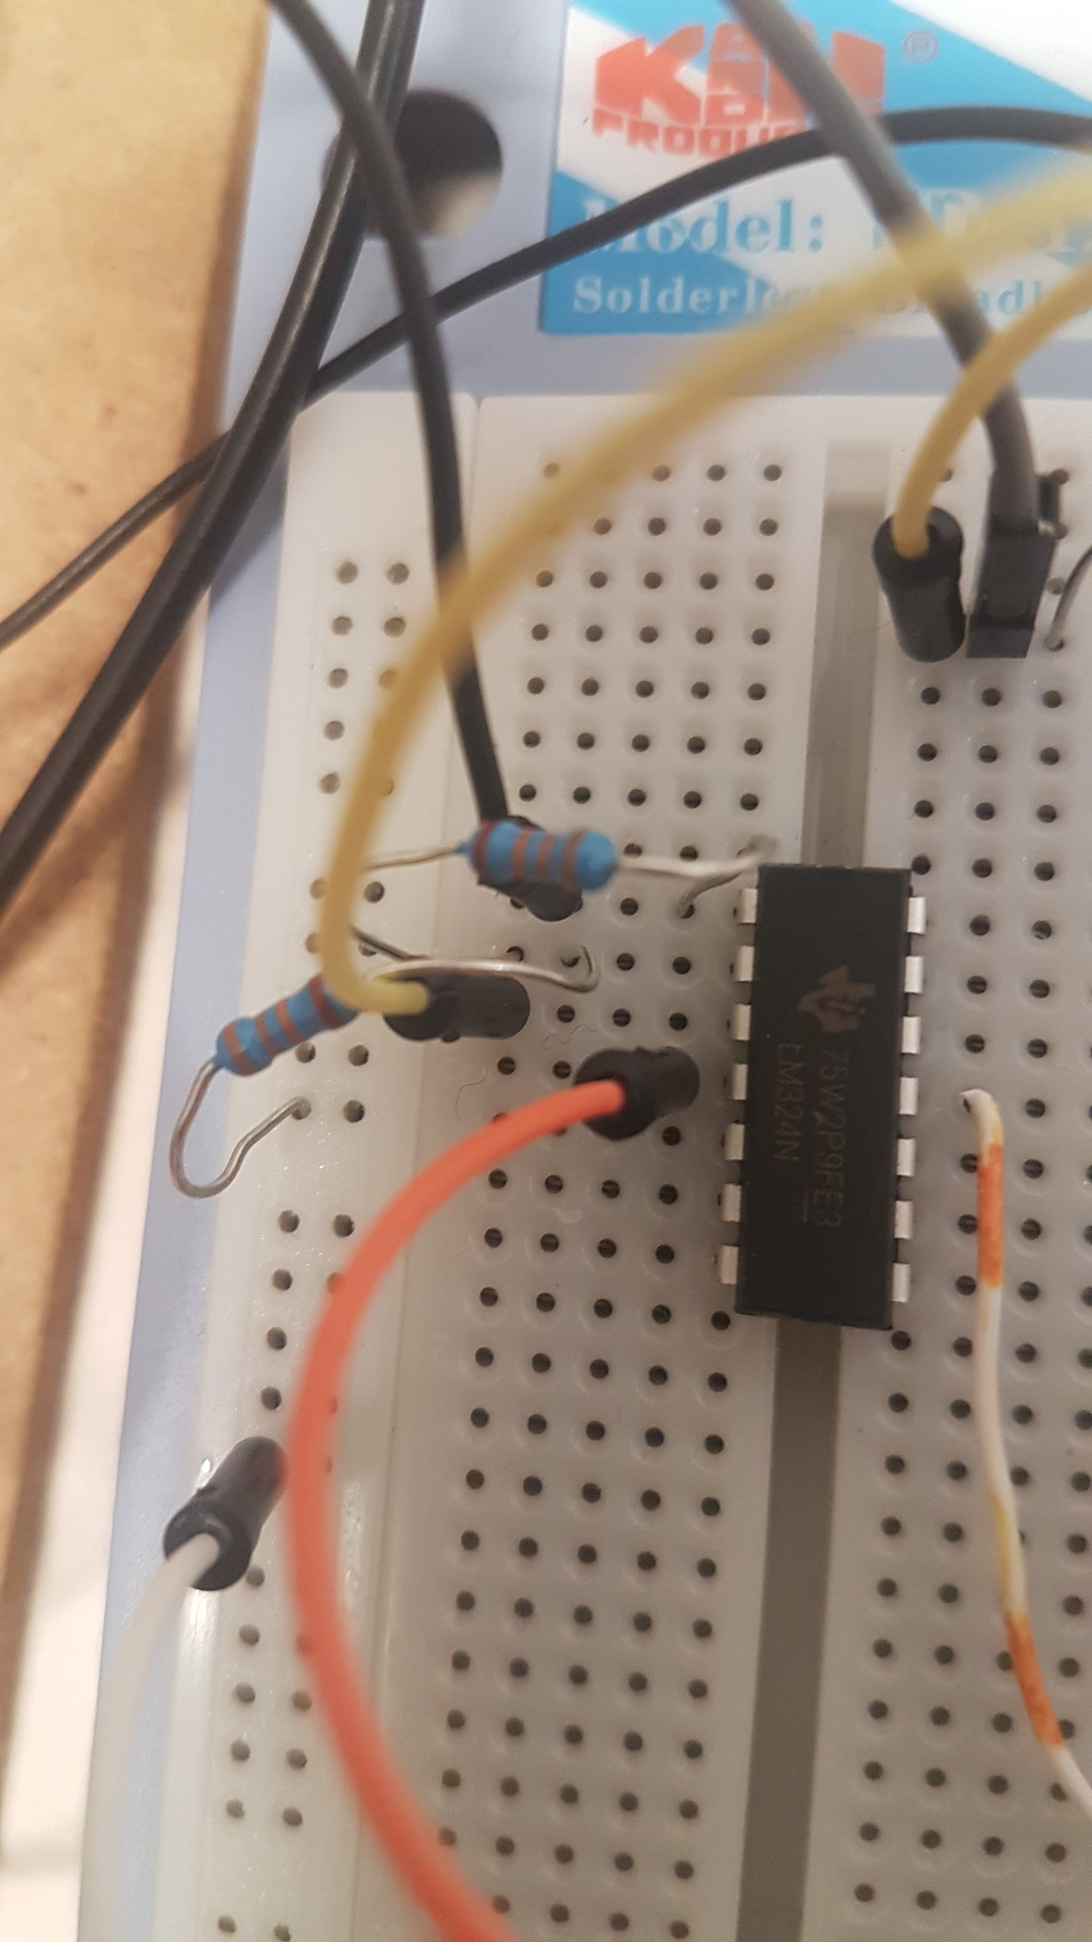
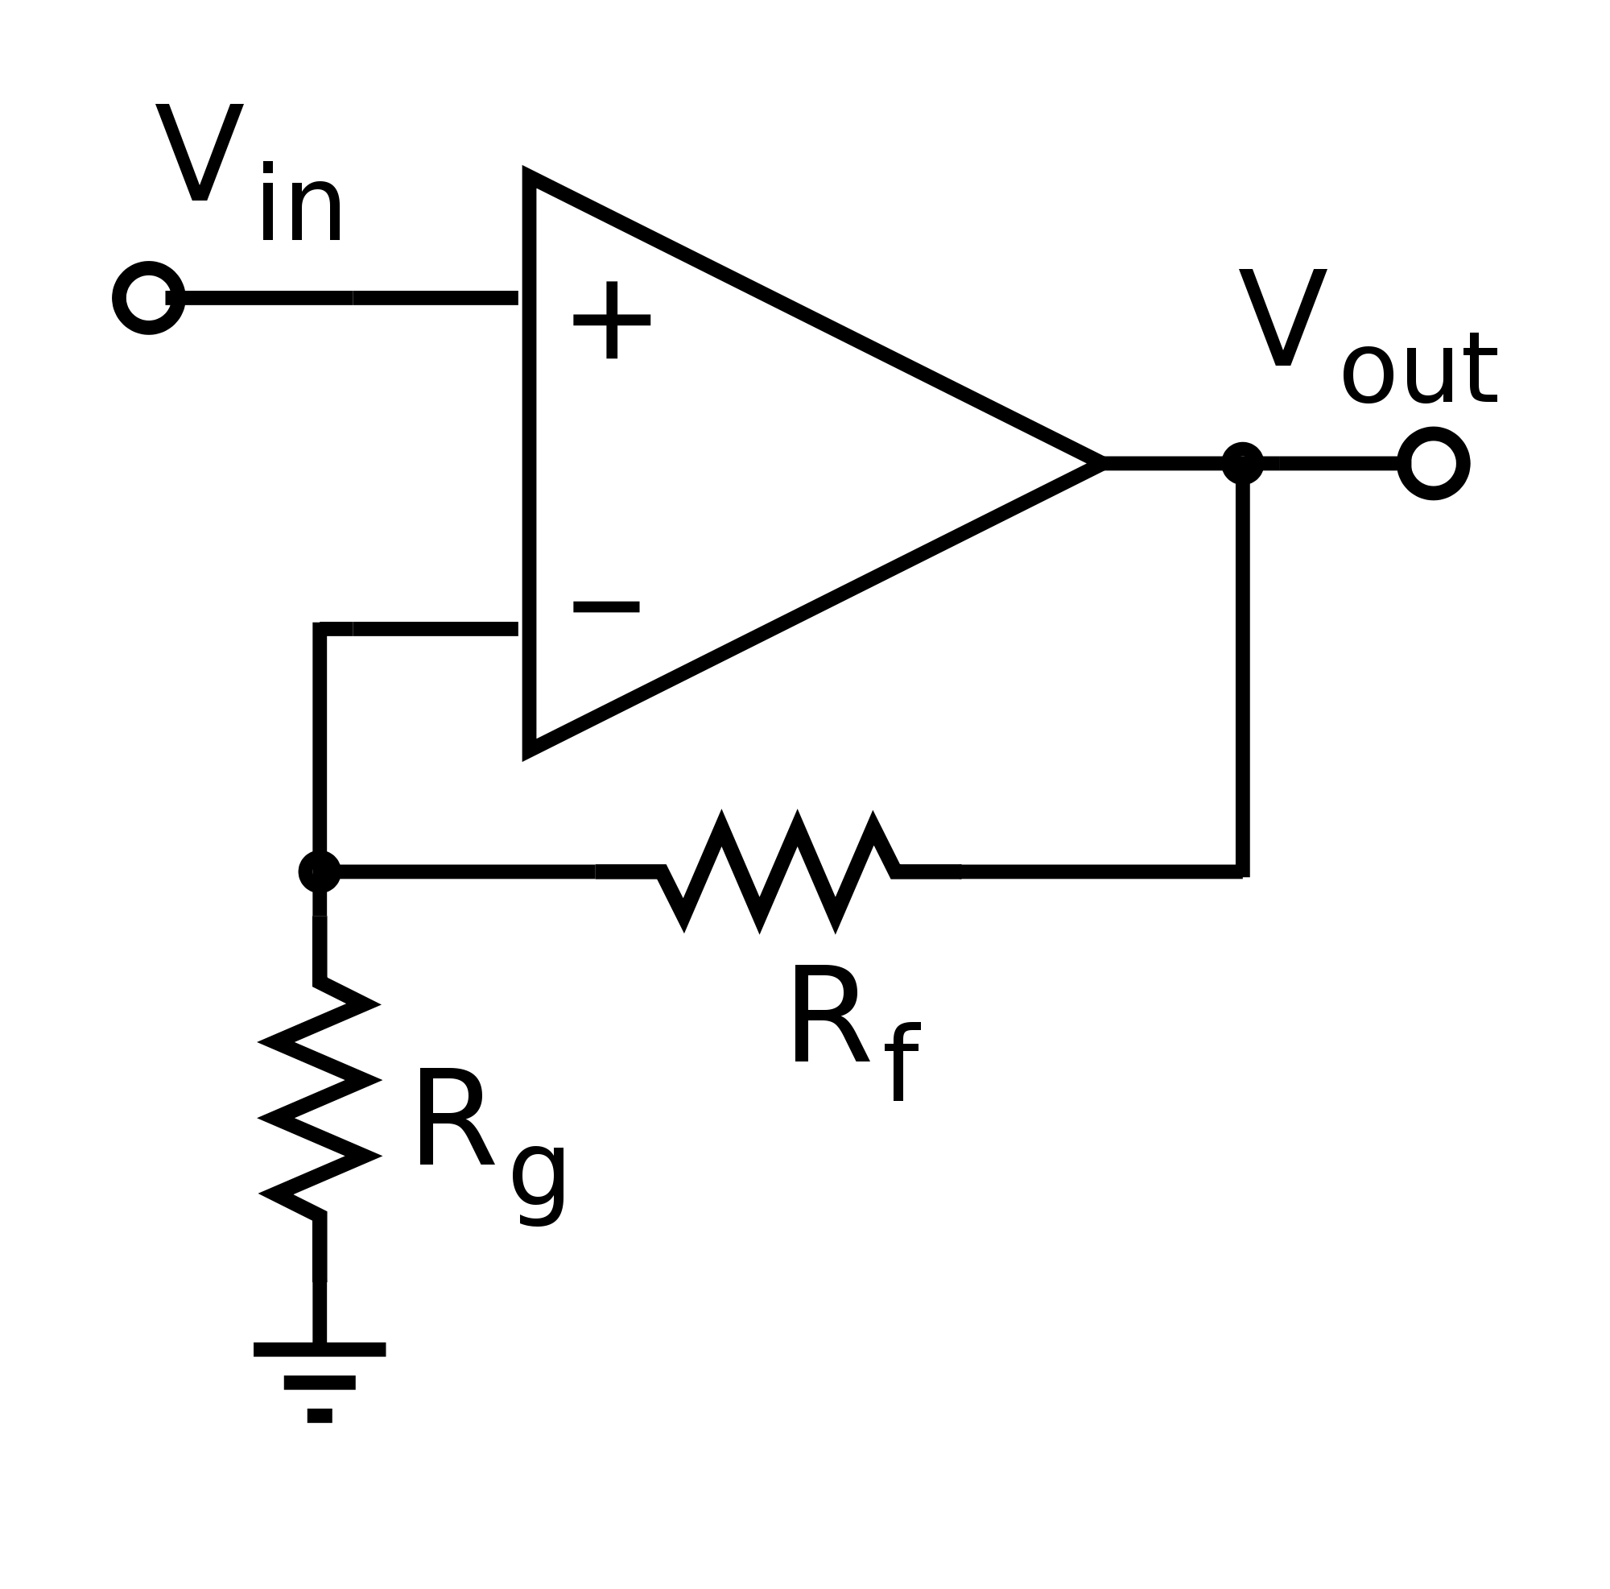
Non-inverting Amplifier LM324N
R_{f} = R_{g} = 33 KΩ have been chosen in such a way that G=2.
Estimation of DC motor load
2/27/18
Page 10

Slide 11
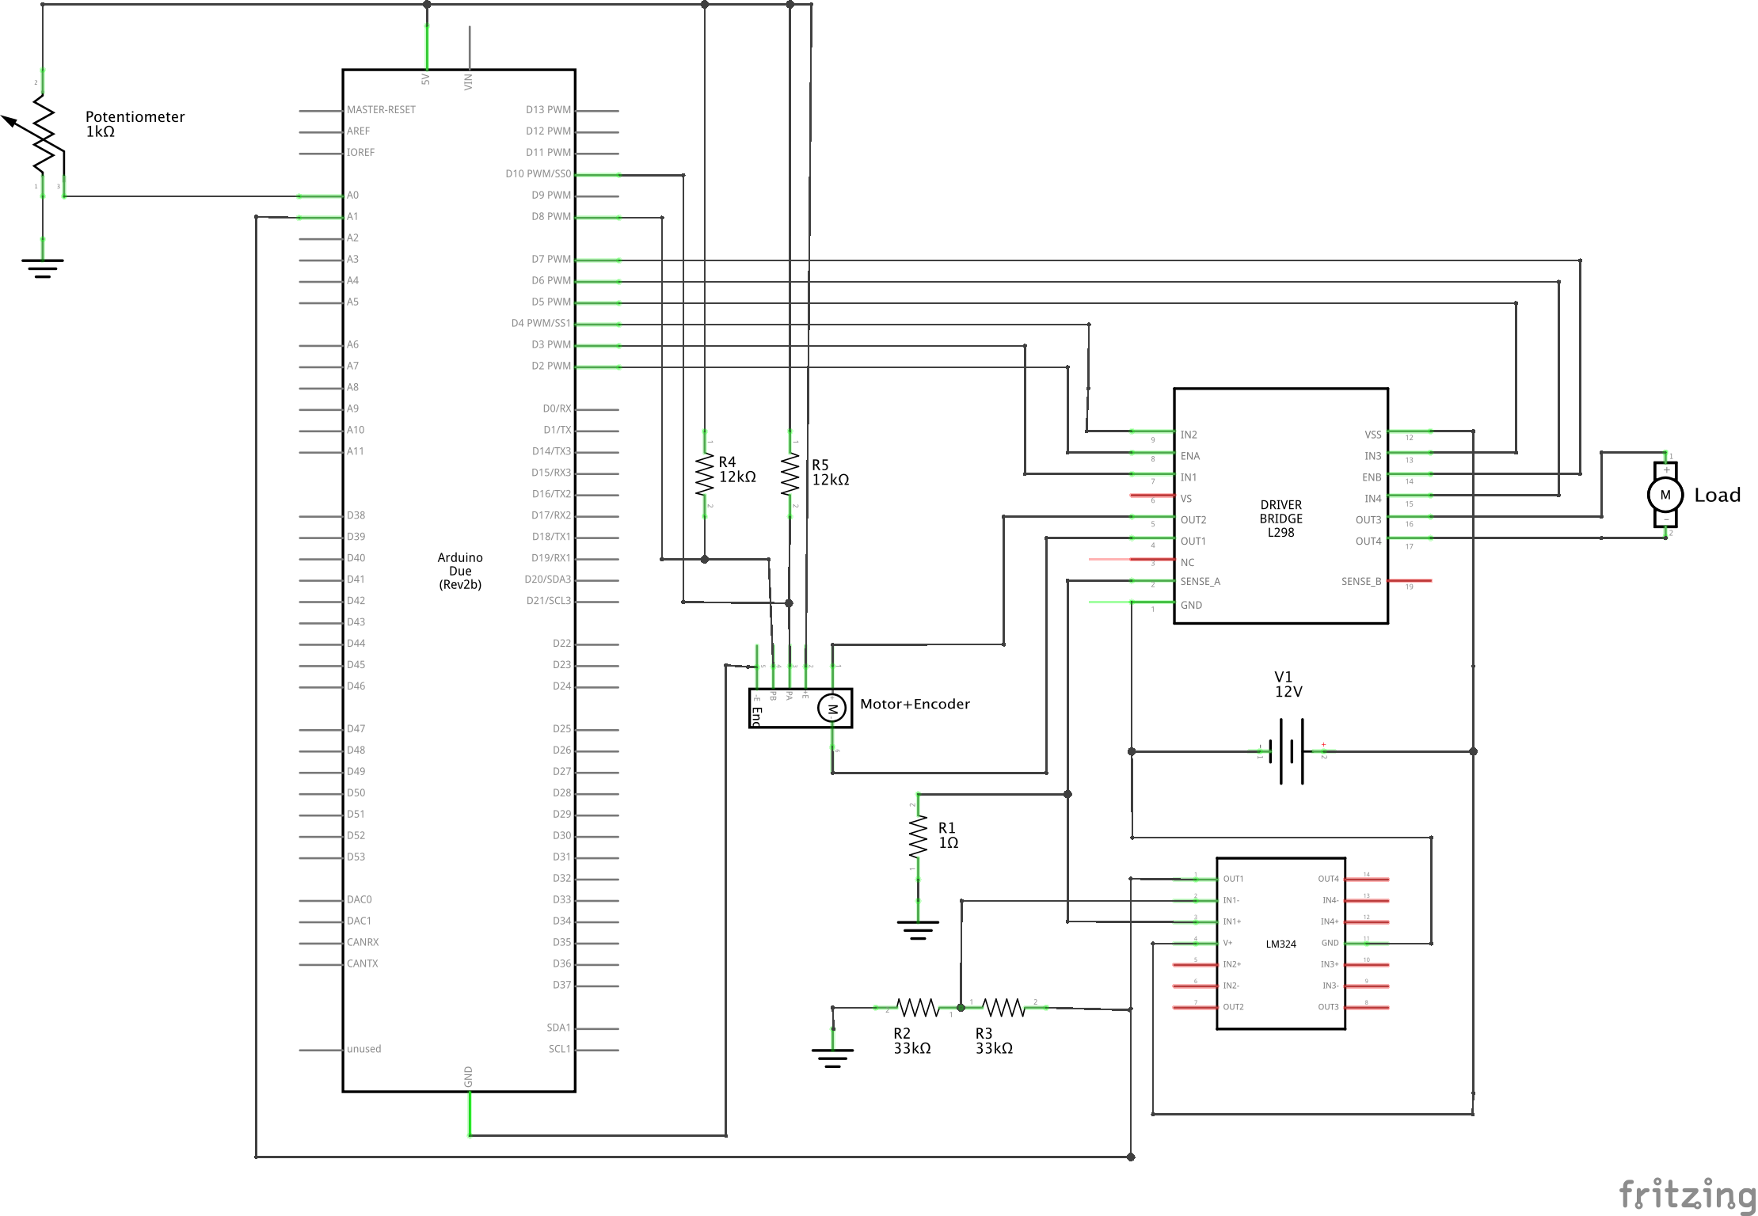
Wiring diagram
Estimation of DC motor load
2/27/18
Page 11

Slide 12
Motor parameters estimation
Motor dynamical equations:
ω, rated speed
J, motor inertia
B, friction
R_{a}, armature resistance
i_{a}, armature current
E_{emf}, back-ElectroMotiveForce
Back-EMF constant:
Estimation of DC motor load
2/27/18
Page <number>

Slide 13
Motor parameters estimation
Where V_{s}= 12 V
i_{a} = 40 mA (rated)
R_{a}= 13.7 Ω (estimated)
ω = 150 RPM = 15,7 rad/s
Back-EMF constant and Torque constant have the same numerical value for DC motors:
So,
Estimation of DC motor load
2/27/18
Page 13

Slide 14
Mechanical time constant estimation
Mechanical time constant:
Time needed by the angular velocity
to reach 63% of final value.
Using:
We can compute motor inertia:
Estimation of DC motor load
2/27/18
Page 14

Slide 15
Load torque estimation
Motor dynamical equations:
Neglecting friction:
At steady state:
We finally know that:
Torque – current relationship
Estimation of DC motor load
Page 15

Slide 16
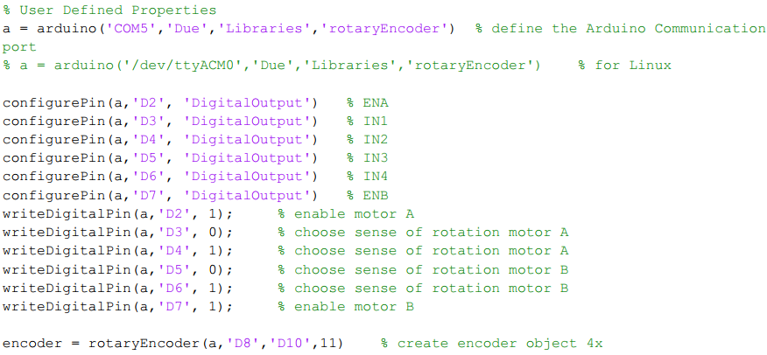
Matlab code: Motor Load Estimation
Estimation of DC motor load
2/27/18
Page 16

Slide 17
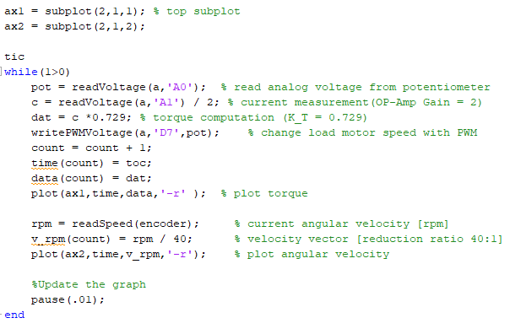
Matlab code: Motor Load Estimation
Estimation of DC motor load
2/27/18
Page 17

Slide 18
Motor Load estimation: a video
Estimation of DC motor load
2/27/18
Page 18

Slide 19
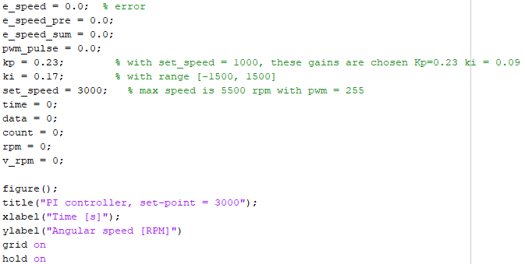
Matlab code: P/PI Speed Controller
Estimation of DC motor load
2/27/18
Page 19

Slide 20
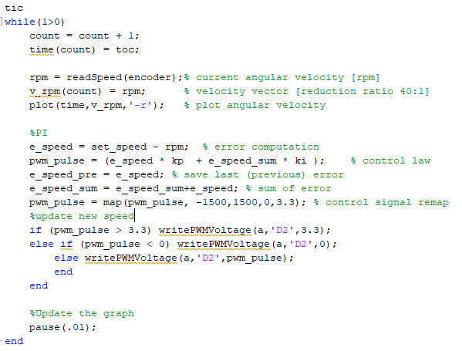

Matlab code: P/PI Speed Controller
Estimation of DC motor load
2/27/18
Page 20

Slide 21
Simulation: P vs PI Controller
Estimation of DC motor load
2/27/18
Page 21

Slide 22
PI controller: a video
Estimation of DC motor load
Page 22

Slide 23
Conclusions
During the development of this project we have:
Learned how to interface Arduino and Matlab for real time simulation and analysis;
Estimated the DC motor parameters in order to obtain an estimate of the motor torque;
Implemented a PI speed controller and seen the effects of the proportional and integral gains.
Future work: possibly, an implementation of a position controller introducing external sensors to create a zero reference signal (mechanical or magnetic switch).
Estimation of DC motor load
2/27/18
Page 23

